Slide 1
Moles/Stoichiometry Review

Slide 2
Compounds
A compound is a substance composed of two or more different elements that are chemically combined in a fixed proportion.
A chemical compound can be broken down by chemical means.
A chemical compound can be represented by a specific chemical formula and assigned a name based on the IUPAC system.

Slide 3
Particle Diagrams
There is usually one particle diagram question on each exam.
Black and white circles are used to represent elements.
They are used to distinguish elements from compounds and simulate chemical reactions. Look at your copies of regents exams for examples.

Slide 4
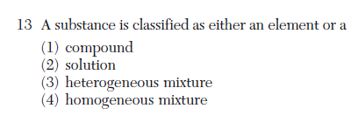


Slide 5
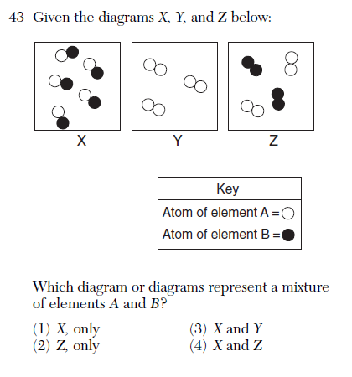
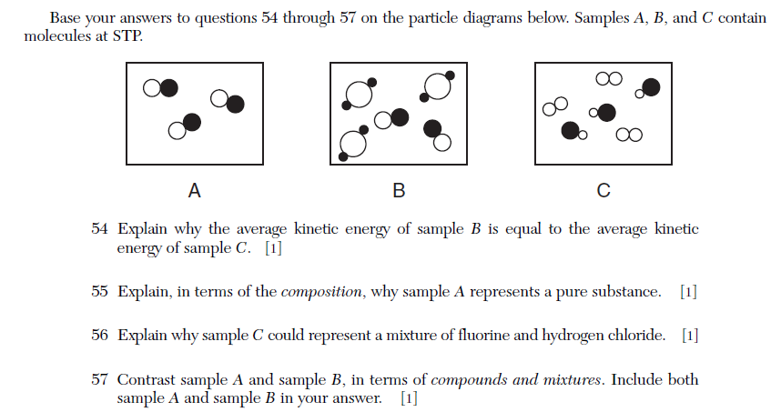
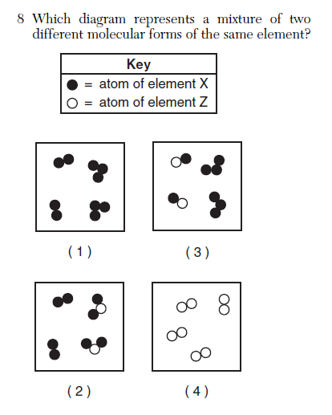

Slide 6
Naming Compounds
There is always one naming question on each exam.
They often use polyvalent metals (Fe, Pb, Cu, Sn, etc) in ionic compounds.
The non-metal oxidation number (always the top one on the periodic table) will allow you to determine the charge on the metal.
Beware of endings on the anion: -ide endings generally mean binary ionic compounds; -ate or –ite endings indicate polyatomic ions (Table E)

Slide 7
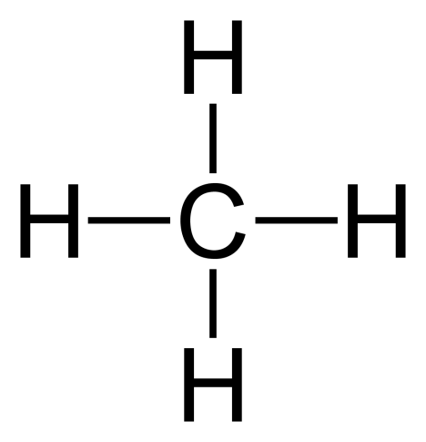
A chemical formula can be represented as an empirical formula, a structural formula, or a molecular formula.
Structural formulas are for organic compounds only.
They are needed because of the existence of isomers for larger molecules.
Remember, a dash represents a pair of shared electrons.

Slide 8
Empirical Formulas
The empirical formula of a compound is the simplest whole-number ratio of atoms of the elements in a compound.
It may be different than the molecular formula, which is the actual ratio of atoms in a molecule of that compound.

Slide 9
The molecular formula is a whole-number multiple of the empirical formula.
Sometimes they will give you molar mass of a compound and its empirical formula.
You must find the “empirical formula mass” and divide the molar mass by the efm.

Slide 10
In all reactions there is a conservation of mass, energy, and charge.
They can ask questions like “Which equation does/does not show conservation of mass?”
This can mean balanced or unbalanced chemical equations, half-reactions or faulty half-reactions, net ionic equations (usually in electrochemistry), which require you to balance electrons.

Slide 11
A balanced chemical equation represents conservation of atoms.
The coefficients in a balanced chemical equation can be used to determine mole ratios in a reaction.
It is a certainty that you will have to balance an equation in at least one question on the exam.

Slide 12
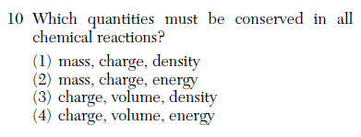
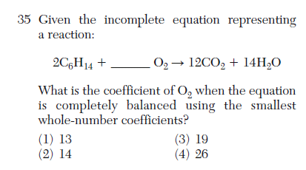
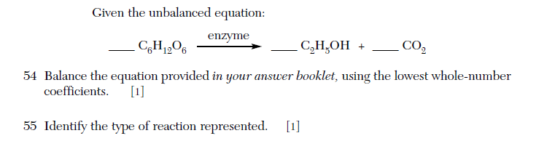
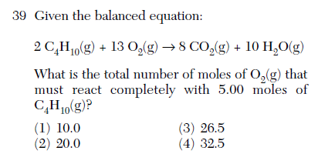

Slide 13
The formula mass of a substance is the sum of the masses of its atoms. The gram-formula mass of the substance equals 1 mole of that substance.
Remember, the atomic mass of everything in a parenthesis in a chemical formula must be multiplied by its subscript when calculating its gram formula mass.
Coefficients in chemical reactions are not included in molar mass calculations!
Table T (back page) has the formula for mole calculations.

Slide 14
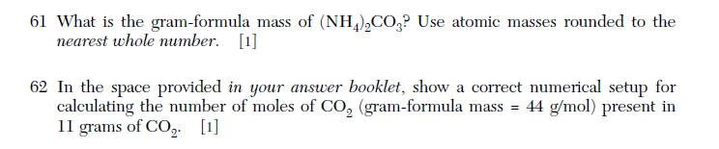


Slide 15
% Composition
The percent composition by mass of each element in a compound can be calculated mathematically.
Table T has this formula also
Note that all compounds with the same molecular formula have the same % composition.

Slide 16
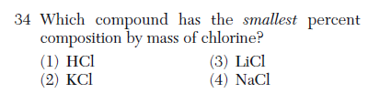

Slide 17
Types of Chemical Reactions
There are many types of chemical reactions, e.g., synthesis, decomposition, single replacement, and double replacement.
All of these reactions except double replacement (and acid-base neutralization) are redox reactions.

Slide 18
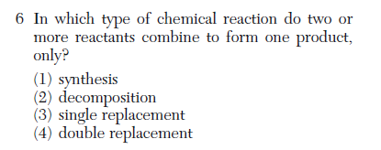
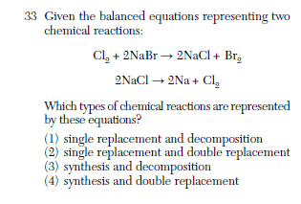

Slide 19
Organic Reactions
There are also a number of organic reactions you must know how to recognize:
substitution (by halogens) of saturated hydrocarbons
addition (by hydrogen and halogens) of unsaturated hydrocarbons
esterification (condensation): alcohol + organic acid 🡪 ester + H₂O
combustion: organic compound + O₂ 🡪 CO₂ + H₂O
fermentation: C₆H₁₂O₆ 🡪 2CH₃CH₂OH + 2 CO₂
saponification: fatty acids + base 🡪 soap + glycerol
There is also addition polymerization and condensation polymerization.

Slide 20
